Slide 1

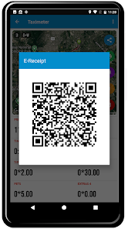
Mobile Application–Based Taxi Meter System
Client: Dr. Subodha Gunawardena
EG/2022/5055 : Hamid K.K.J
EG/2022/5198 : Munasinghe M.A.B.M
EG/2022/5239 : Perera M.T.J.P
EG/2022/5297 : Rodrigo W.T.N

Slide 2
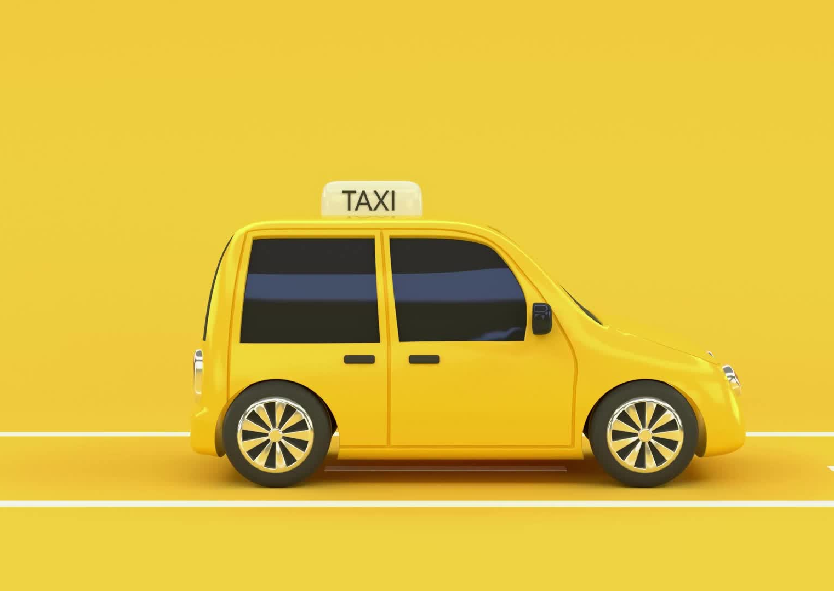
INTRODUCTION
Traditional taxi meters are expensive to install and maintain.
Existing ride-hailing apps charge high commissions.
Independent taxi drivers lack transparent and affordable fare systems.
Passengers have difficulty verifying drivers and fare authenticity.
Internet-dependent systems fail during connectivity issues.(low connection areas)
Need for a lightweight, transparent, and offline-capable solution?

Slide 3
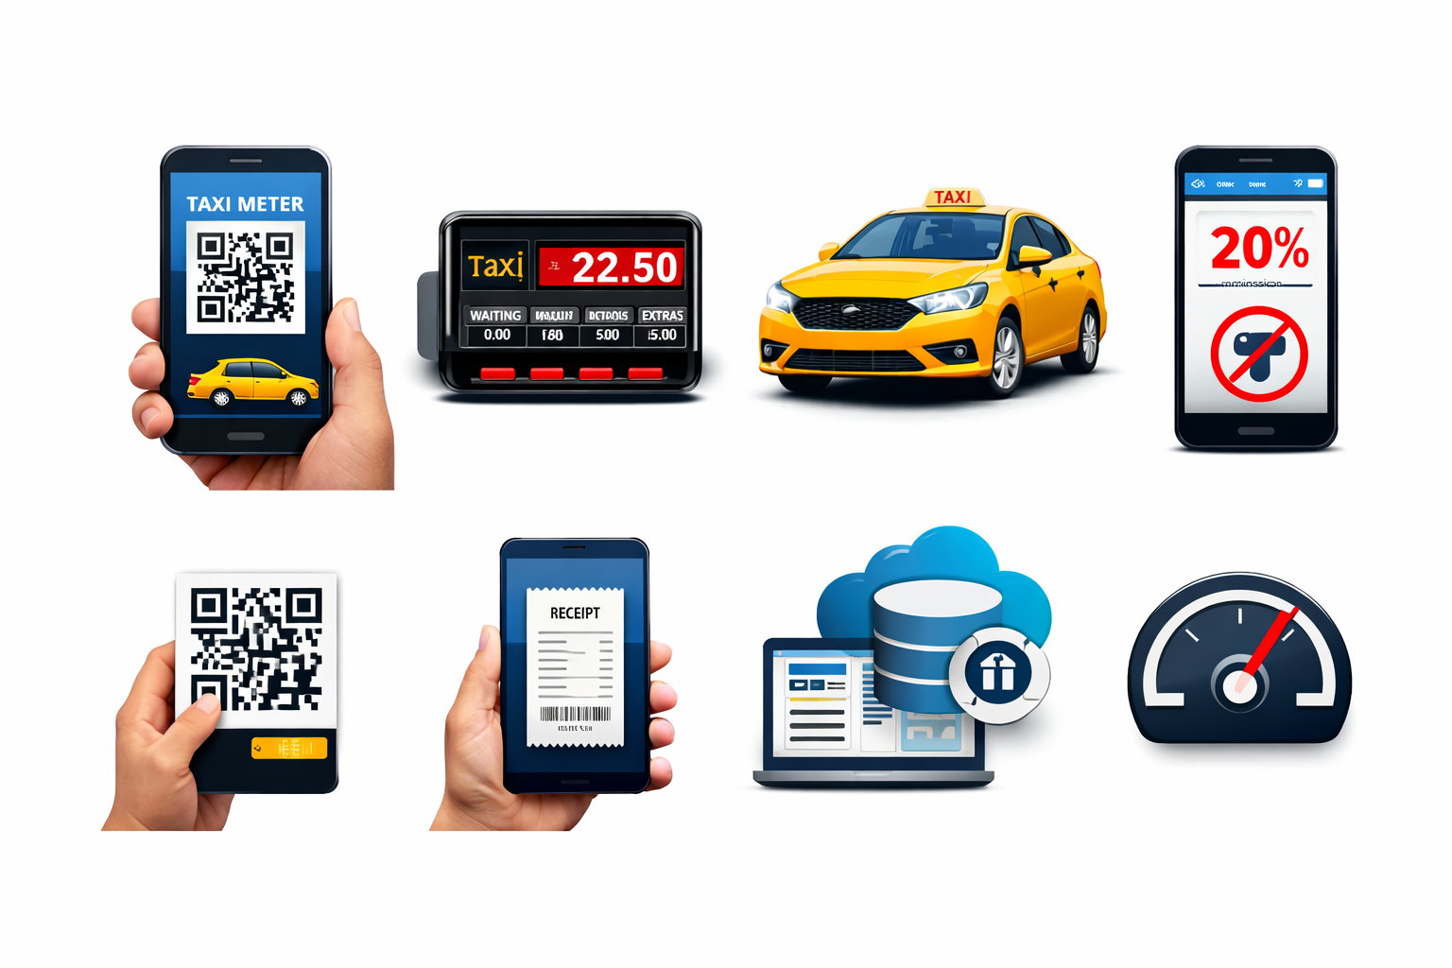

OBJECTIVES
QR-Based Driver Verification
Unique government-issued QR code for each driver
Allows customers to verify driver identity and rates
Transparent Fare Management
Drivers set per-kilometer rates
Area-wise average rate comparison with visual indicators
Digital Trip & Income Management
Automatic fare calculation
Digital receipt generation and trip history
Income tracking for drivers and regulators
Reliable Offline Operation
Fare calculation and receipt generation without internet access

Slide 4
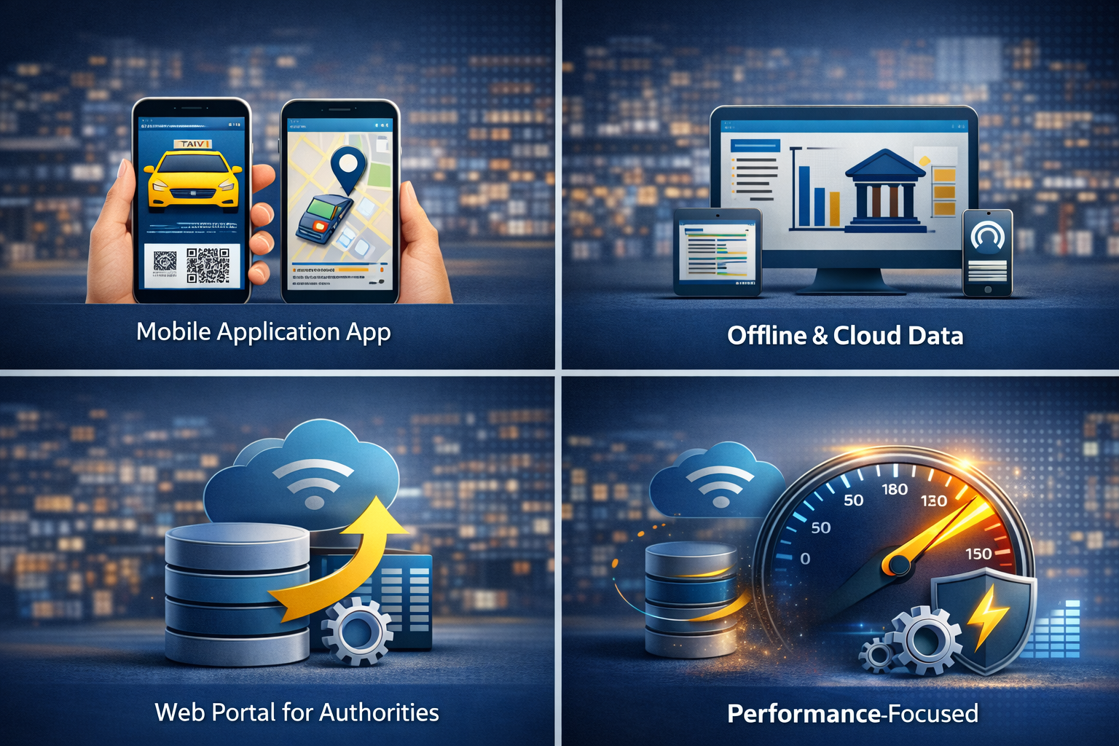


SCOPE OF THE PROJECT
Mobile Application
Android based app for drivers and passengers.
QR scanning, rate viewing, trip tracking, and receipt generation.
Offline & Online Data Handling
Local SQLite database for offline functionality.
Optional cloud synchronization for central monitoring.
Regulatory Support
Web dashboard for government authorities.
Driver verification and rate monitoring.
Performance-Oriented Design
Minimal data usage.
Fast response and lightweight architecture.

Slide 5
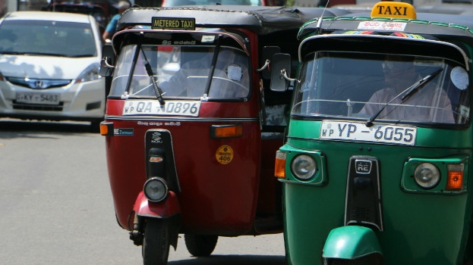
THANK YOU!

